Slide 1
ML4EO Bootcamp - 5th May 2021
Introduction to Machine Learning
Part II
Dr. Andrew Katumba, Makerere University

Slide 2

Artificial Intelligence, Machine Learning and Deep Learning
A set of techniques that enable machines
to mimic human behavior
A subset of AI techniques that enable machines
to improve with experience
A subset of ML techniques that make the training of multi-layer neural networks feasible
Source: https://www.edureka.co/blog/ai-vs-machine-learning-vs-deep-learning/
Industrial automation

Slide 3
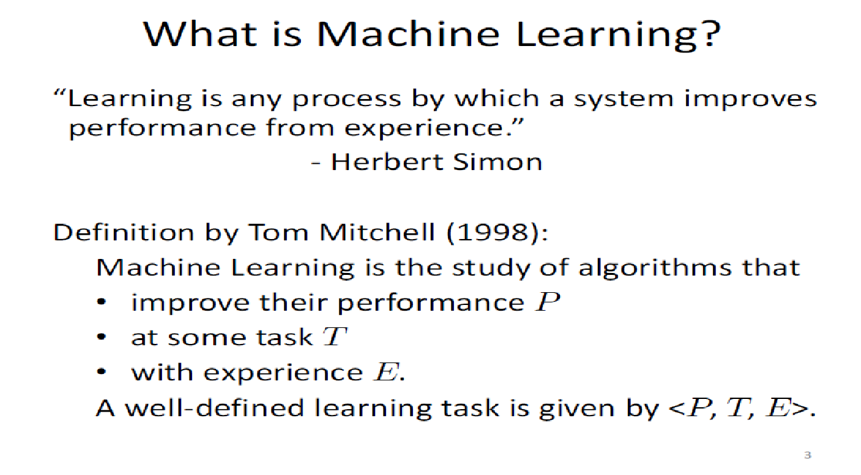
What is Machine Learning?

Slide 4
Traditional Programming
Machine Learning
Data
Computer
Output
Program
Data
Computer
Program
Output
Source: https://courses.cs.washington.edu/courses/cse446/09wi/slides/intro.ppt

Slide 5
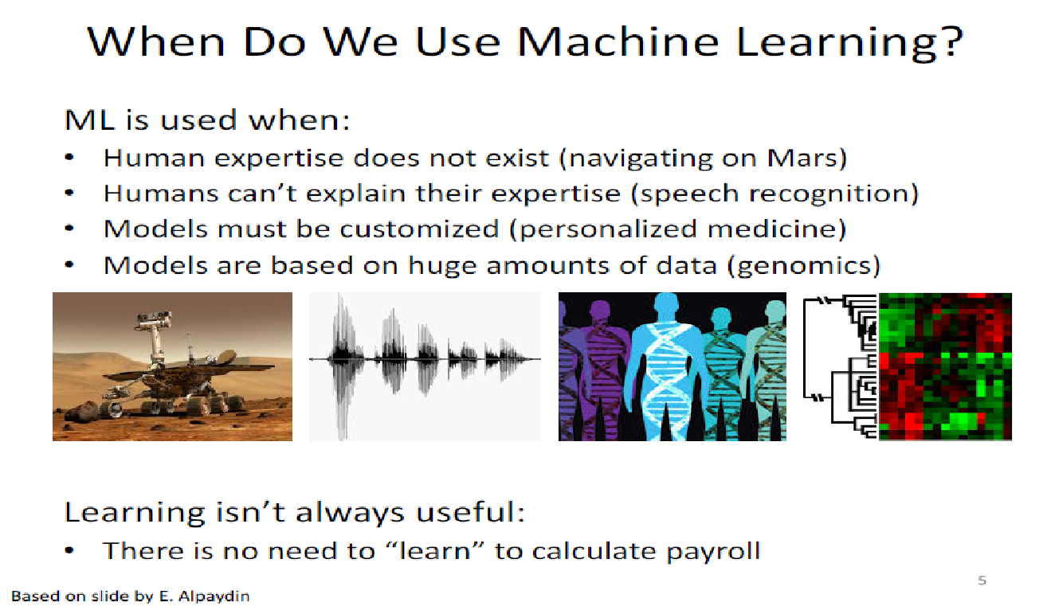
When Do We Use Machine Learning?
Based on a Side by E Alpaydin

Slide 6
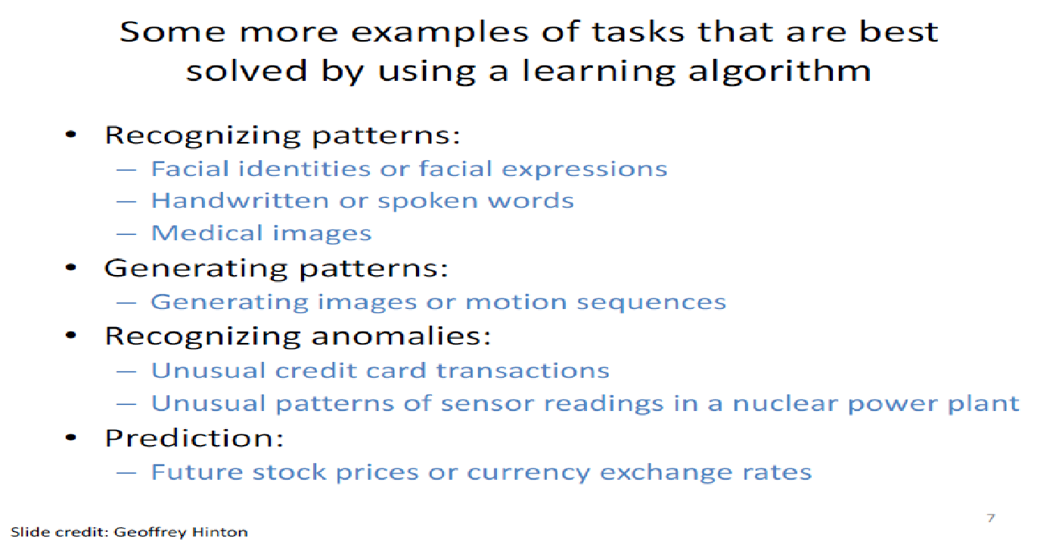
Some more examples of tasks that are best solved by using a learning algorithm
Slide Credit: Geoffrey Hinton

Slide 7
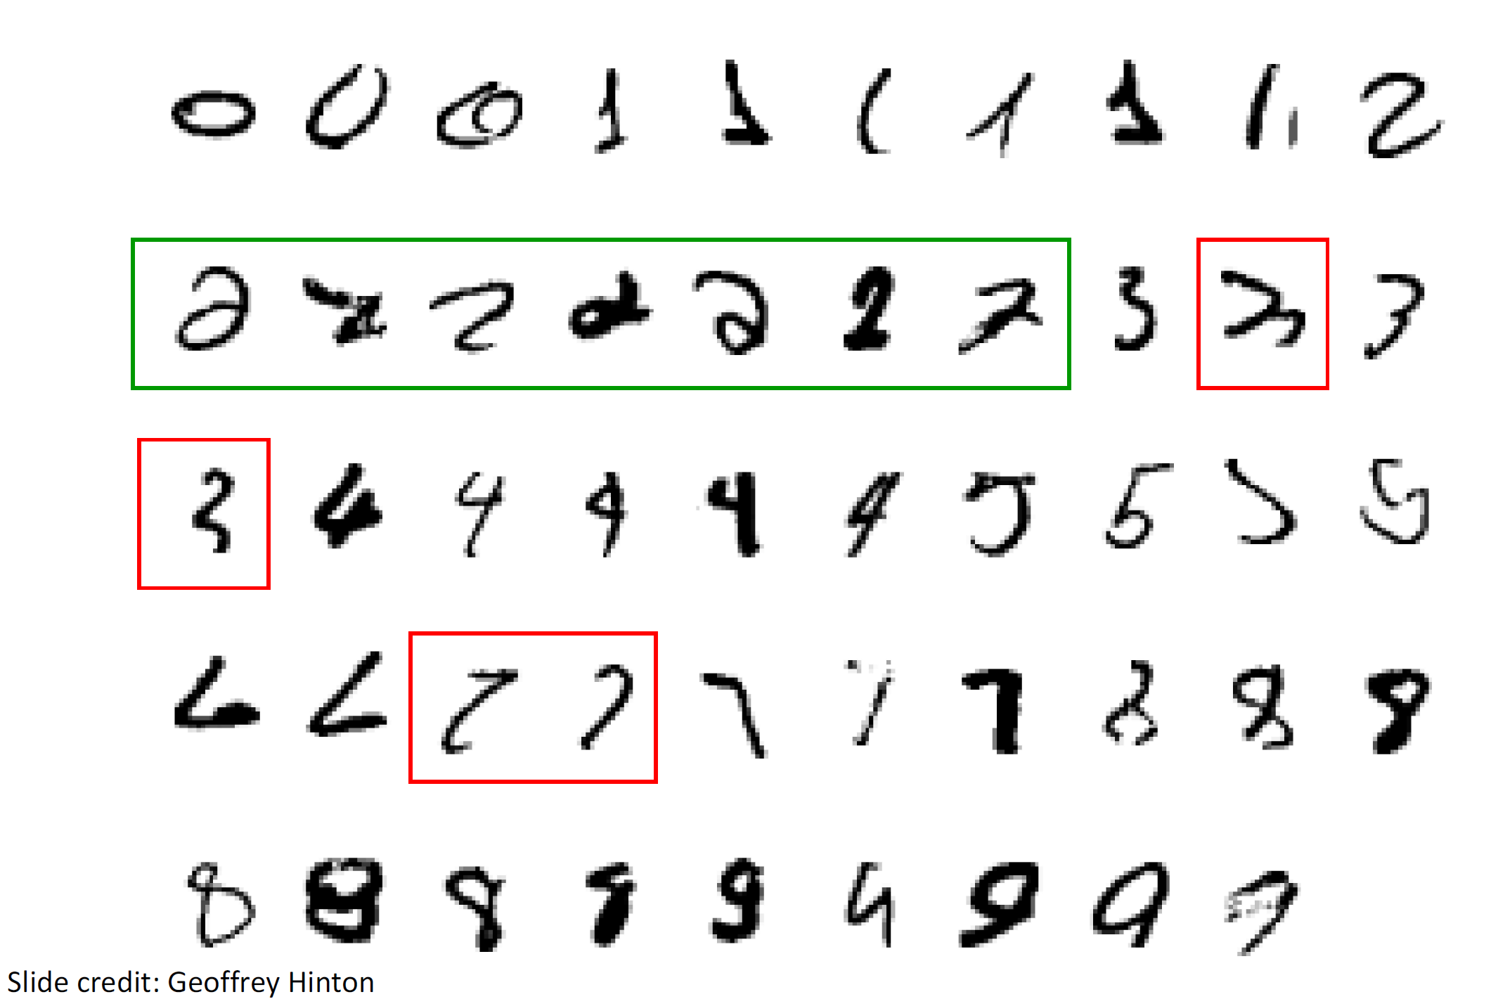
A classic example of a task that required machine learning: it is very hard to say what makes a 2

Slide 8
Sample Applications
Web search
Computational biology
Finance
E-commerce
Space exploration
Robotics
Information extraction
Social networks
Debugging software
Disease recognition in crops
[Your favorite idea]
Based on slide by Pedro Domingos

Slide 9

ML State-of-the-Art

Slide 10
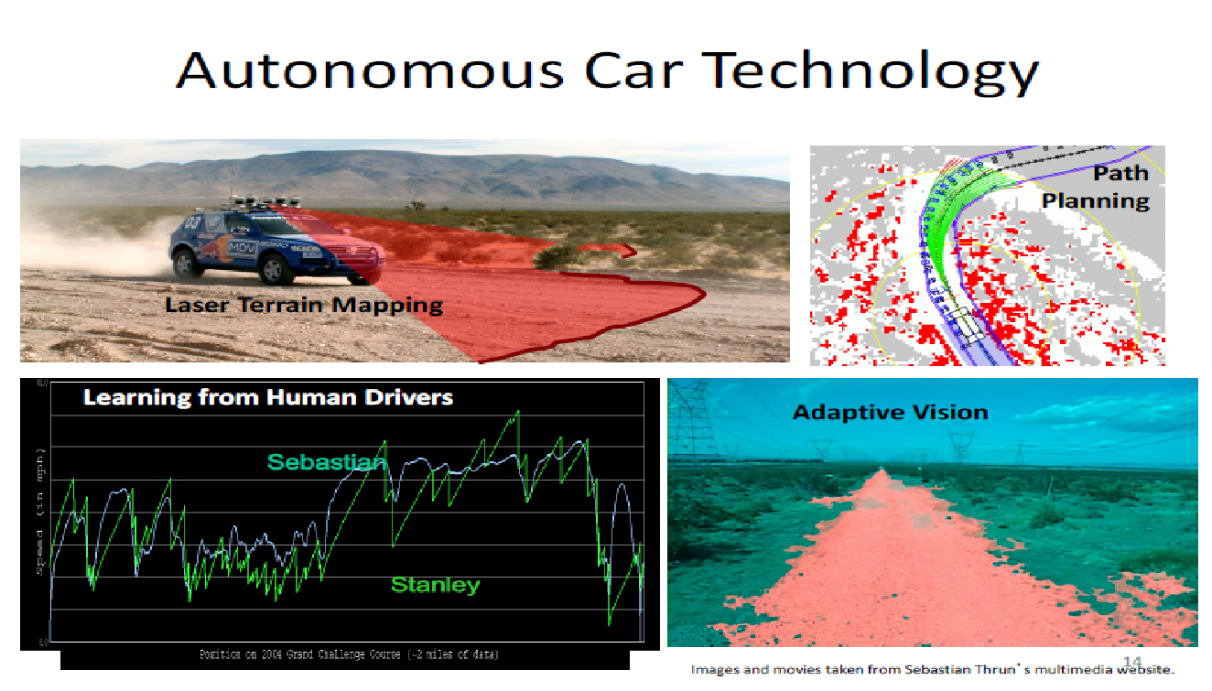
Autonomous Car Technology

Slide 11
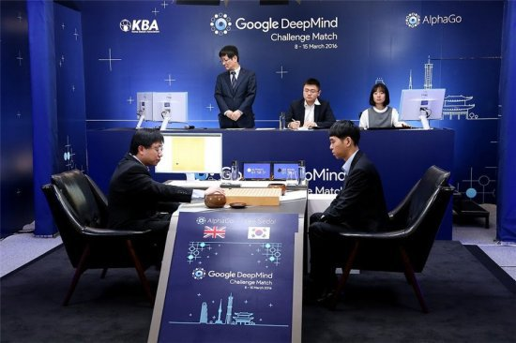

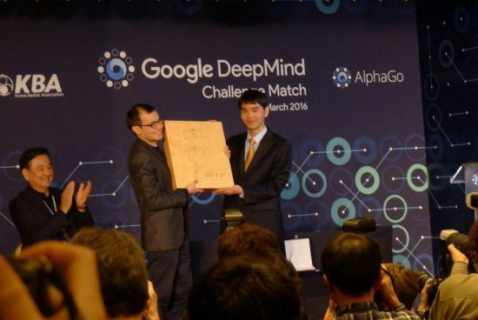
AlphaGo Lee
AlphaGo Lee
Vs
Lee Sedol
李世石
黃士傑
李世石
AlphaGo won by 4-1
AlphaGo
A combination of neural network and algorithm
9 and 15 March 2016

Slide 12
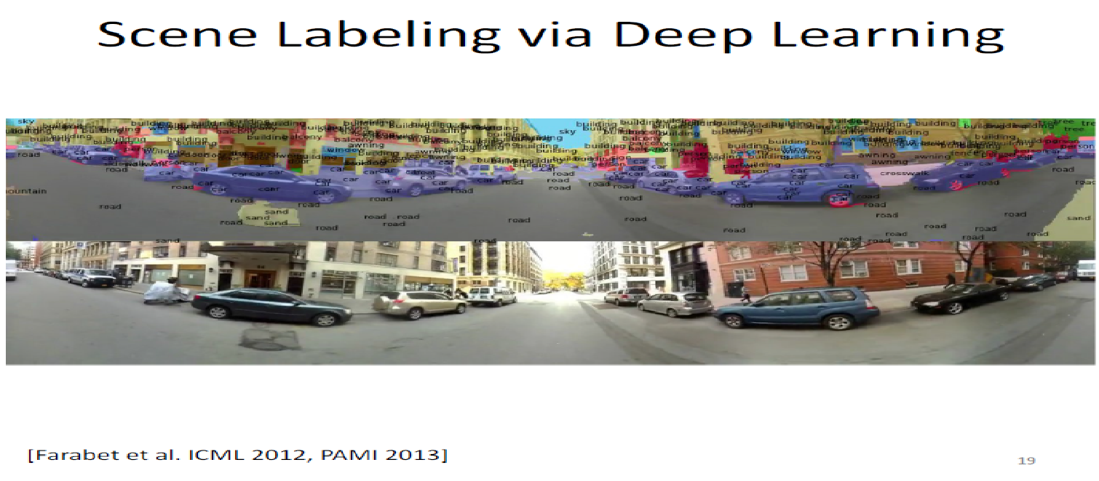
Scene Labeling via Deep Learning
[Farabet et al. ICML 2012, PAMI 2013]

Slide 13
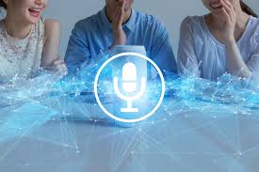
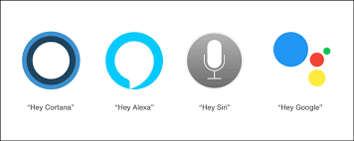
Impact of Deep Learning in Speech Technology

Slide 14
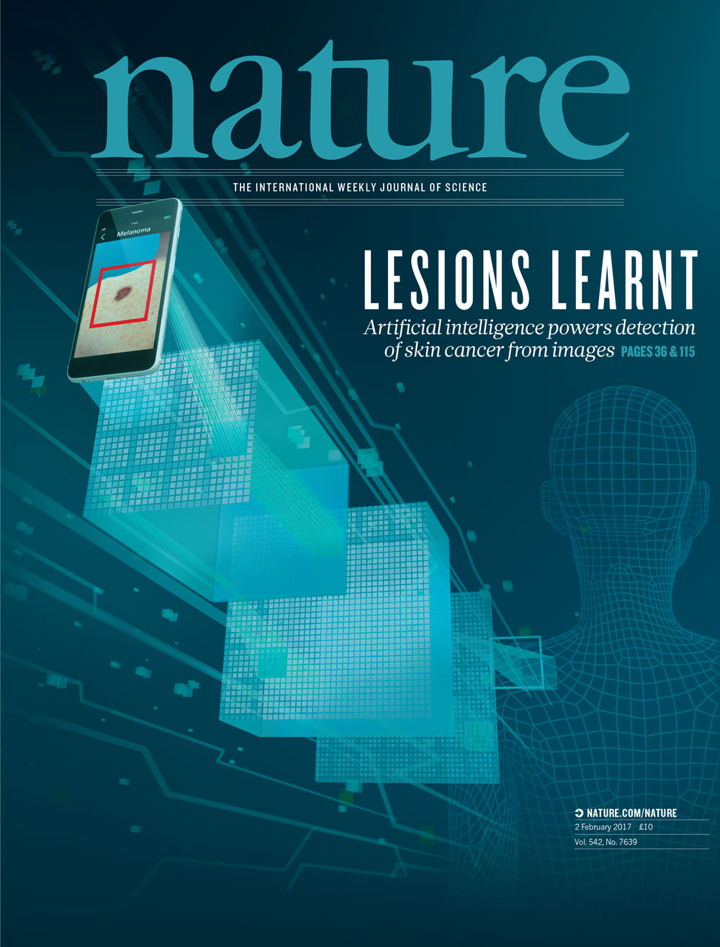
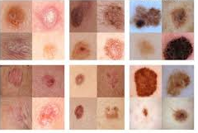
Medical Image Analysis
Epidermal Lesions
Melanocytic Lesions
(Demoscopy)
Melanocytic Lesions
Benign
Malignant

Slide 15
ML at Makerere University

Slide 16
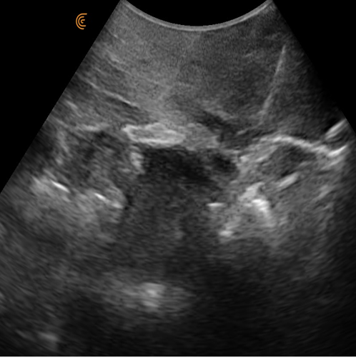
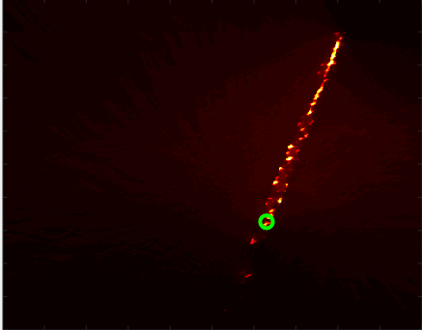
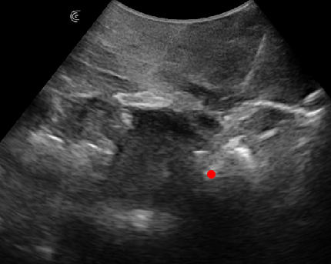
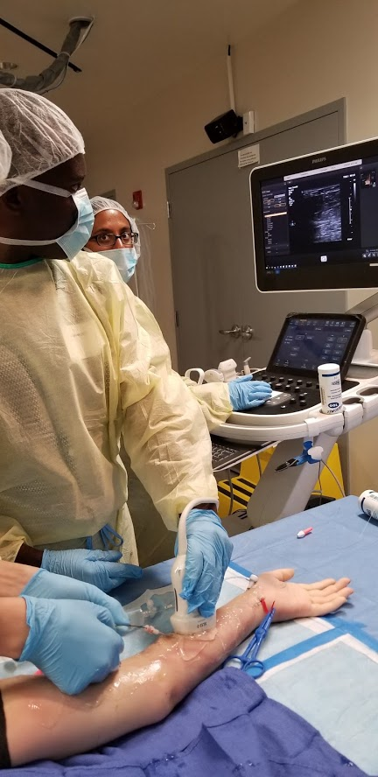
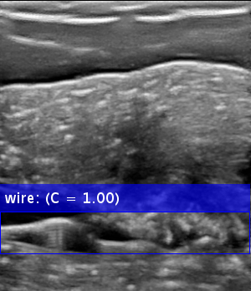
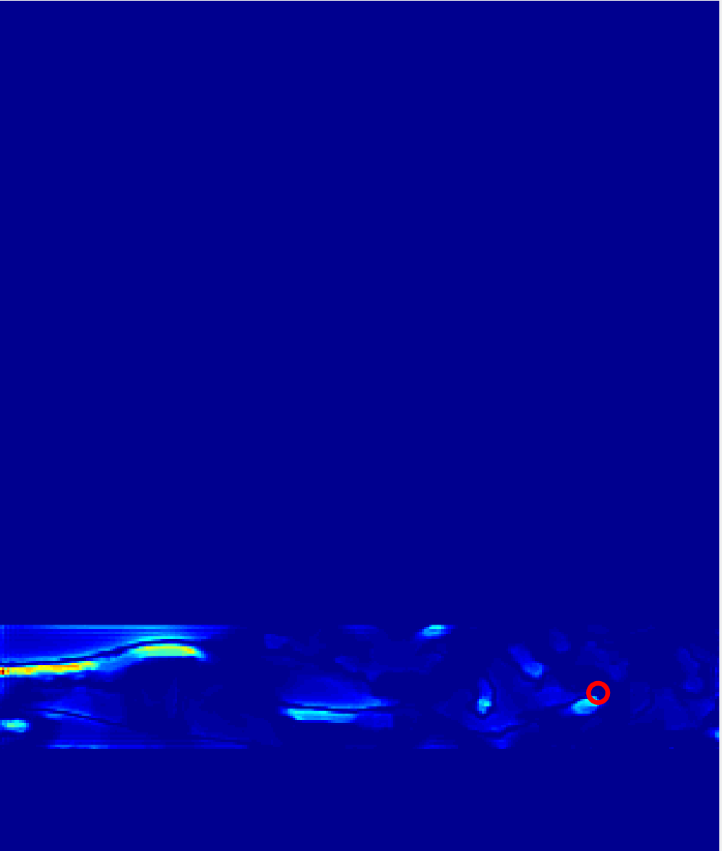
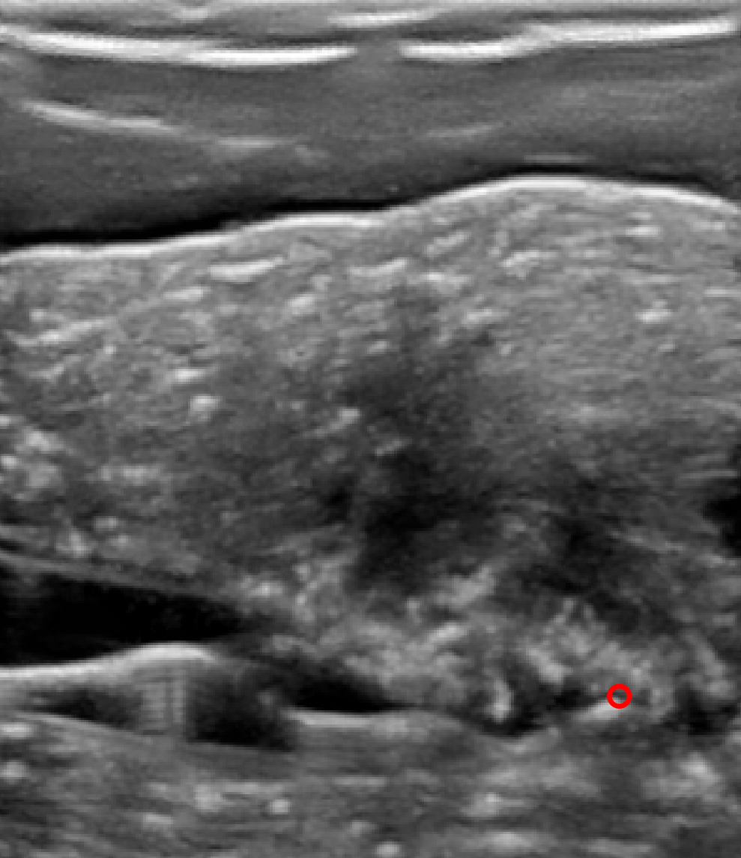
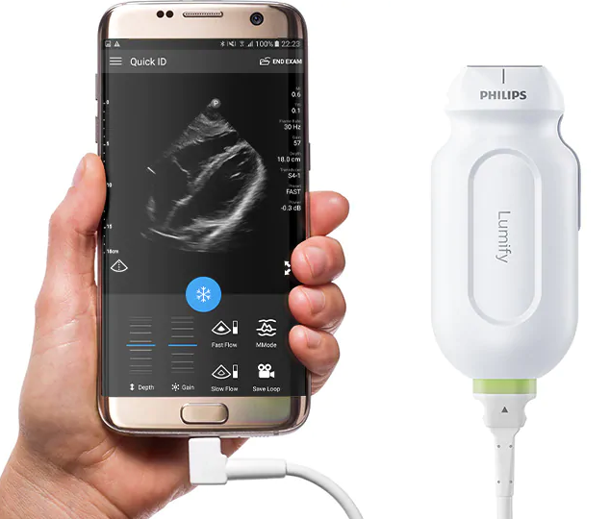
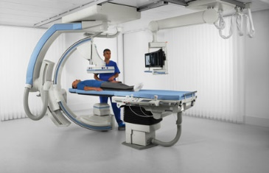
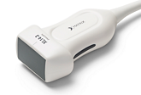
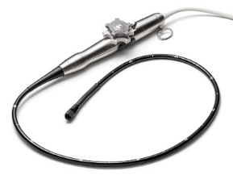
Computer Aided Diagnosis and Interventions (CADI) Lab
Surgical tool (needles, guidewires, catheters, atherectomy devices) enhancement and automatic tip localization in image-guided interventions (biopsies, cardiovascular interventions, regional anesthesia, fetal interventions)
Conventional ultrasound
Needle tip
Guidewire tip
Portable ultrasound
3D ultrasound
Fluoroscopy
Transesophageal
ultrasound

Slide 17
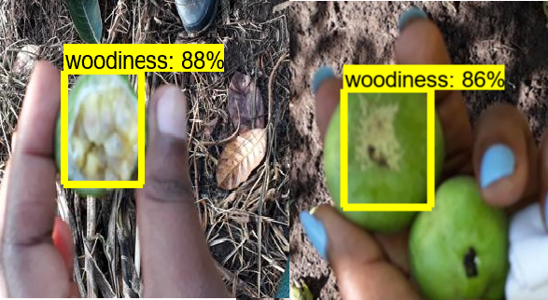
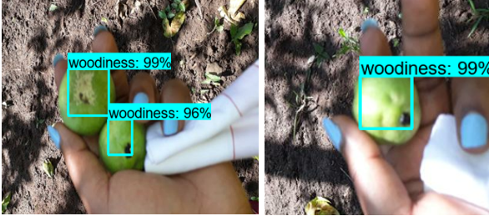
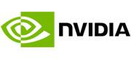

A Portable, Deep Learning-based Diagnostic Platform for Plant Diseases
A low-cost, portable platform for diagnosing passion fruit (and other plant) diseases
Recipient of an NVIDIA Corporation GPU seeding grant
http://www.netlabsug.org/

Slide 18
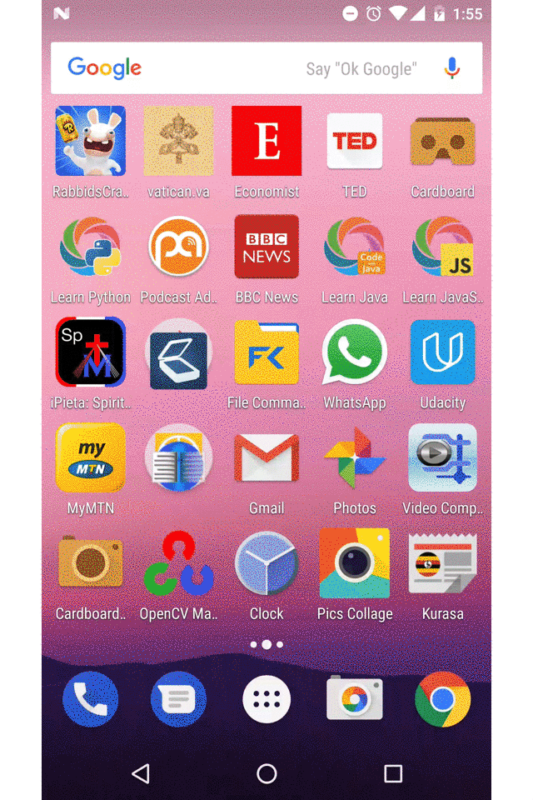
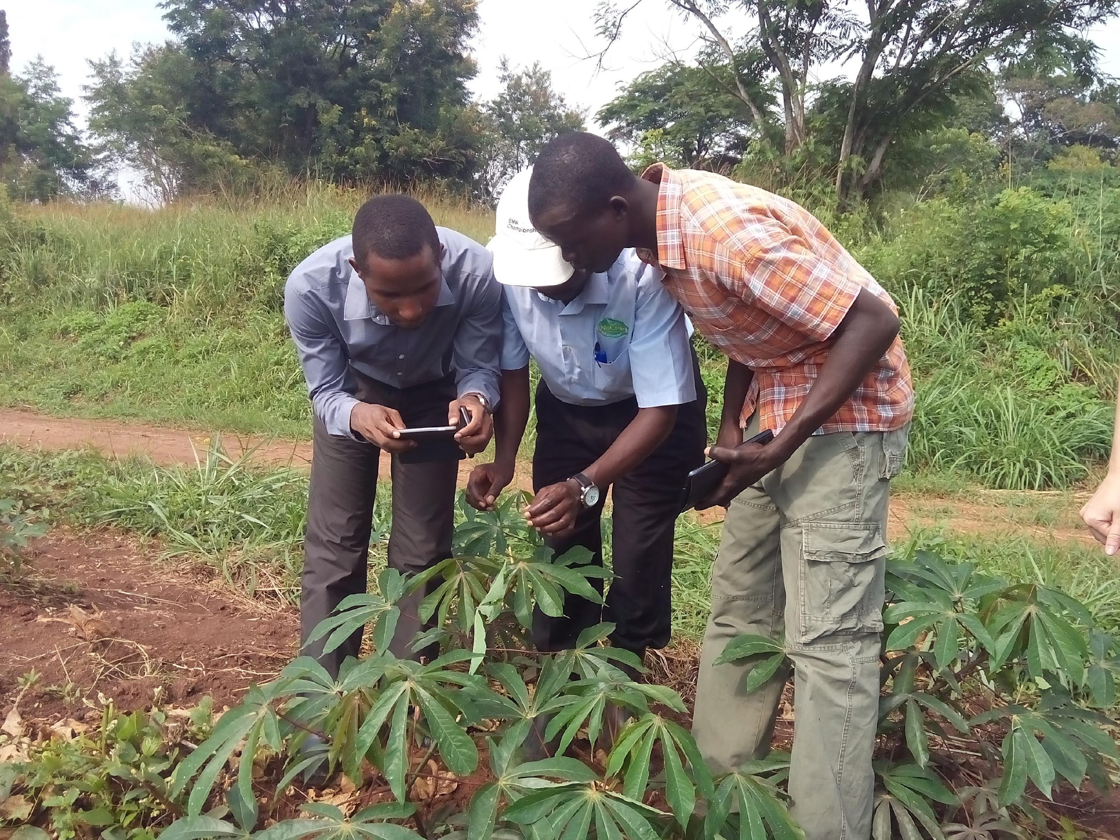

Crop Disease Surveillance

Slide 19
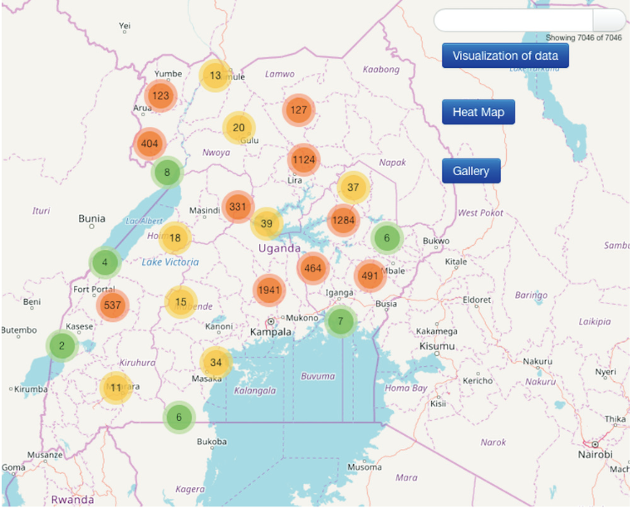
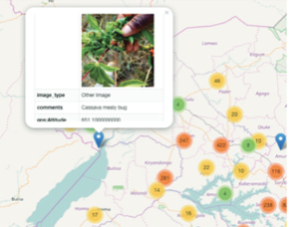
Incidence mapping

Slide 20
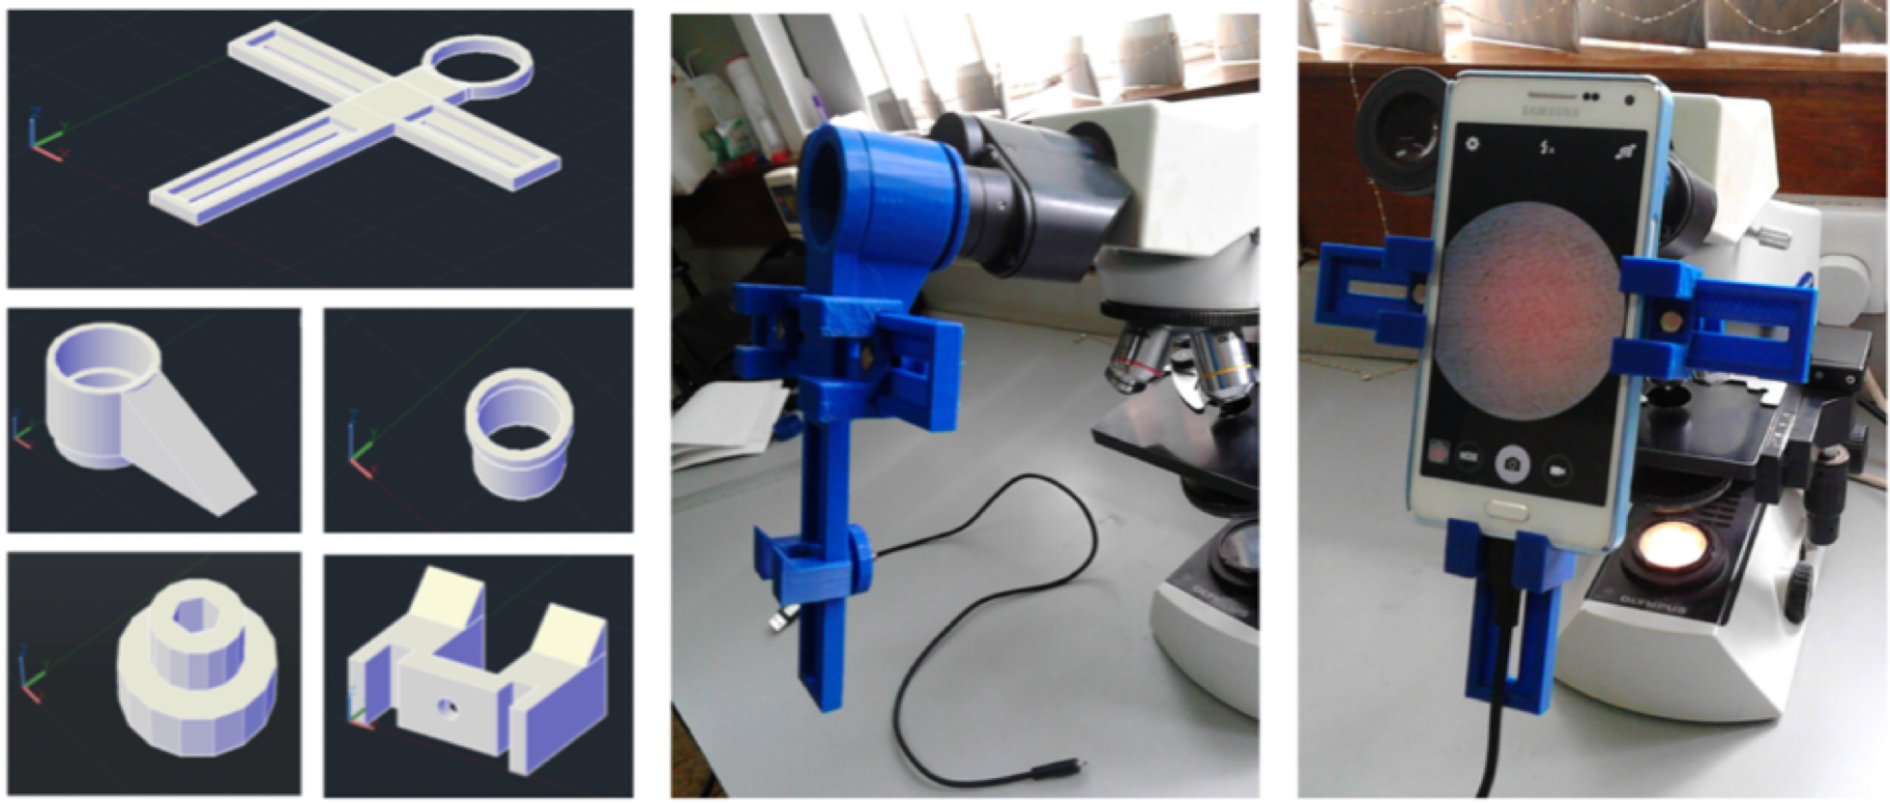
Automated Lab Diagnostics - mobile microscopy

Slide 21
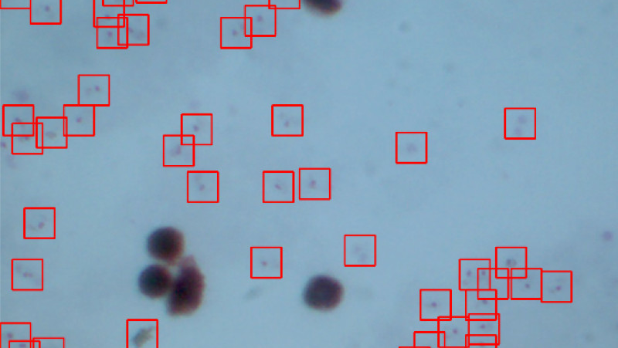
Detection of plasmodium falciparum in blood smear – using Machine Learning

Slide 22
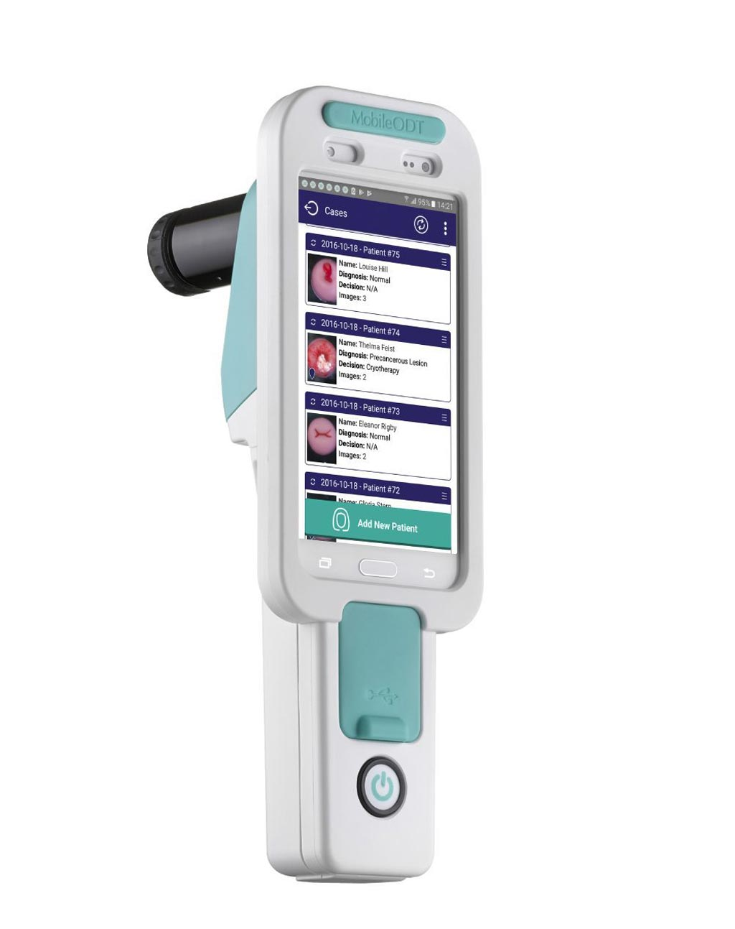
Diagnosis of Cervical Cancer
Applying machine learning to classification of images of cervical cancer

Slide 23
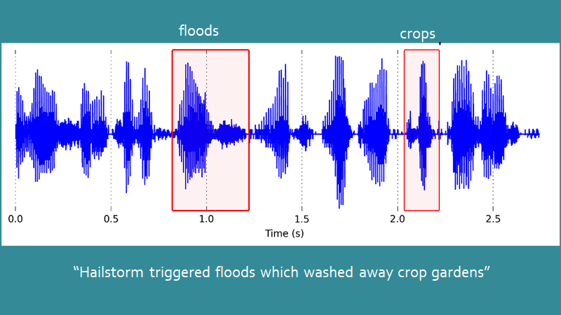
Radio mining

Slide 24
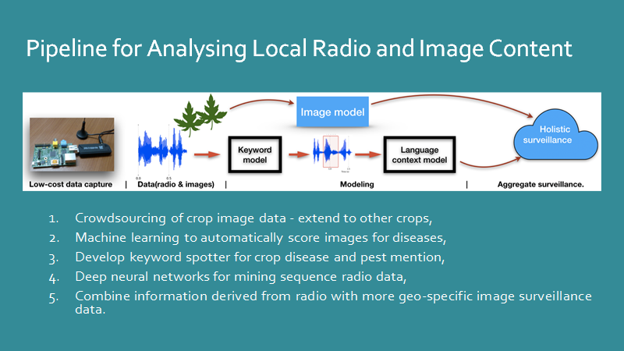

Slide 25
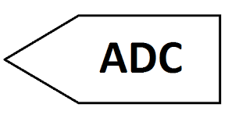
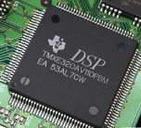
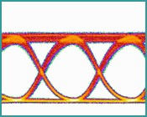
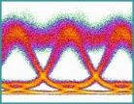
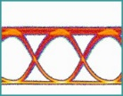
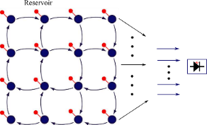

Equalization in IM-DD NRZ optical links
IM-DD – Intensity Modulation Direct Detection
Optical Neural Networks vs Digital Signal Processing
Power hungry
Latency limit
Speed limit
Optical signal
DSP
Equalization
Low power consumption(potentially)
Fast, no latency issues
Photonic RC chip
PHRESCO
No Electro-optic conversions for the processing
Dr. Andrew Katumba, CEDAT, Makerere University

Slide 26
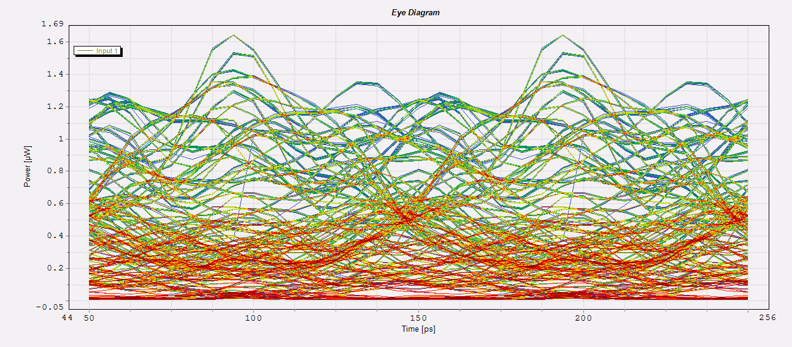
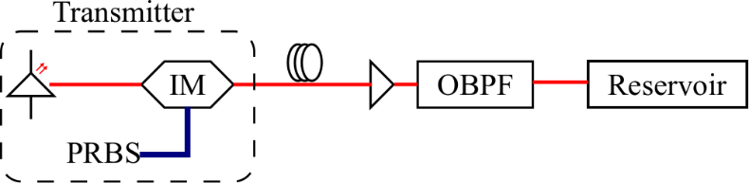
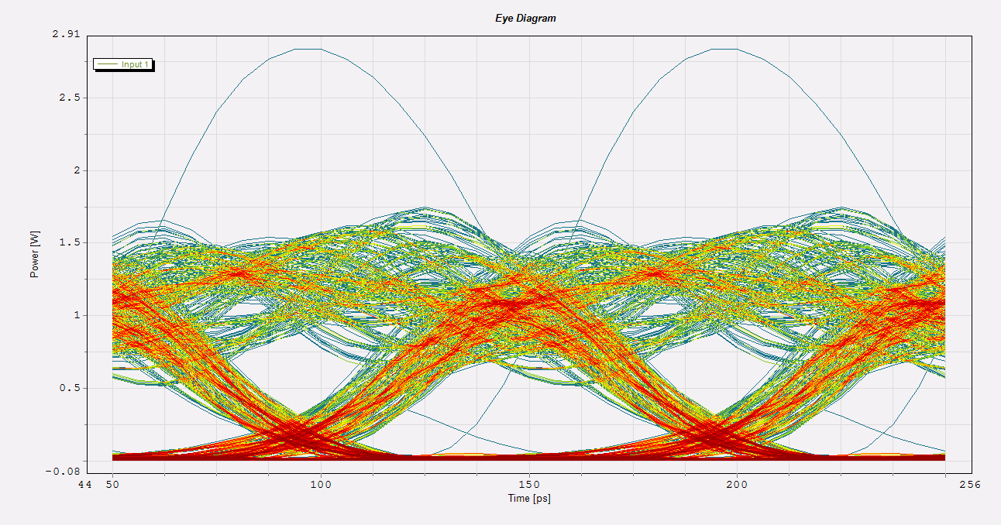
Optical Neural Networks can outdo imperfections in metro links
Simulations
NRZ OOK 10 Gb/s
16 node swirl reservoir
10mW launch power
150km fiber
A good benchmark for telecom applications:
Input in optical domain
Need for high speed and low power
PHRESCO
Dr. Andrew Katumba, CEDAT, Makerere University

Slide 27
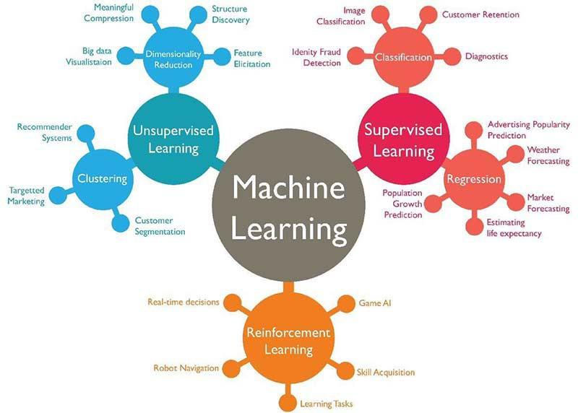
3 Types of Learning

Slide 28
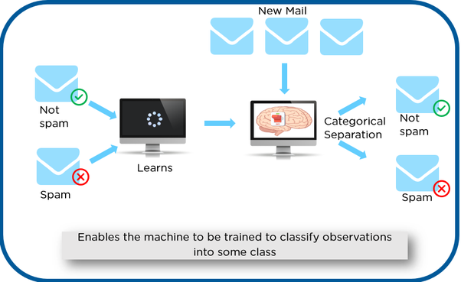
Overview of Supervised Learning
Input data is labelled
Goal is to approximate mapping function that predicts correct output for unseen data
Examples: Classification, Regression

Slide 29
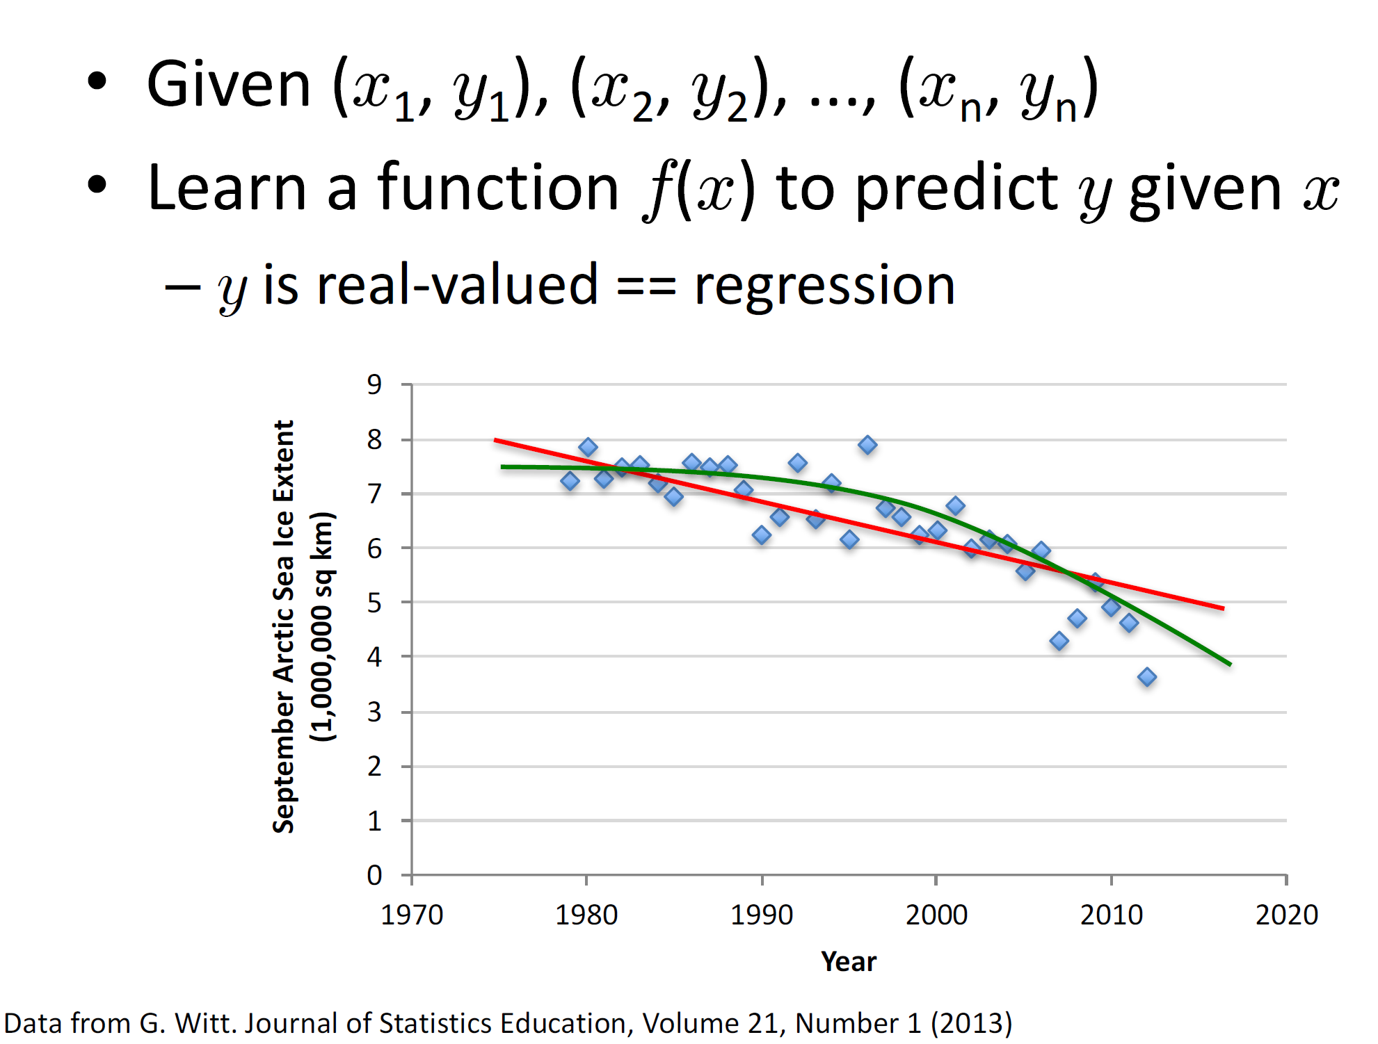
Supervised Learning: Regression

Slide 30
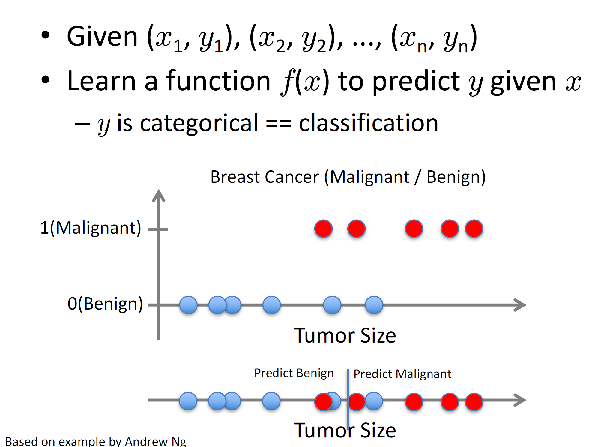
Supervised Learning: Classification

Slide 31
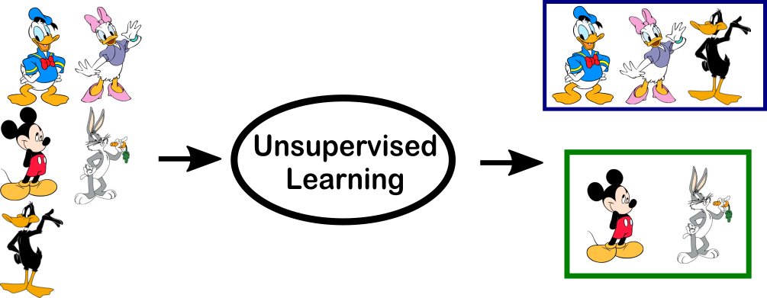
Overview of Unsupervised Learning
Input data is not labeled
Output hidden structure behind the input data
Examples:
Clustering: Discover the inherent groupings in the data, such as grouping customers by purchasing behavior.
Association: Discover rules that describe large portions of your data, such as people that buy X also tend to buy Y.

Slide 32
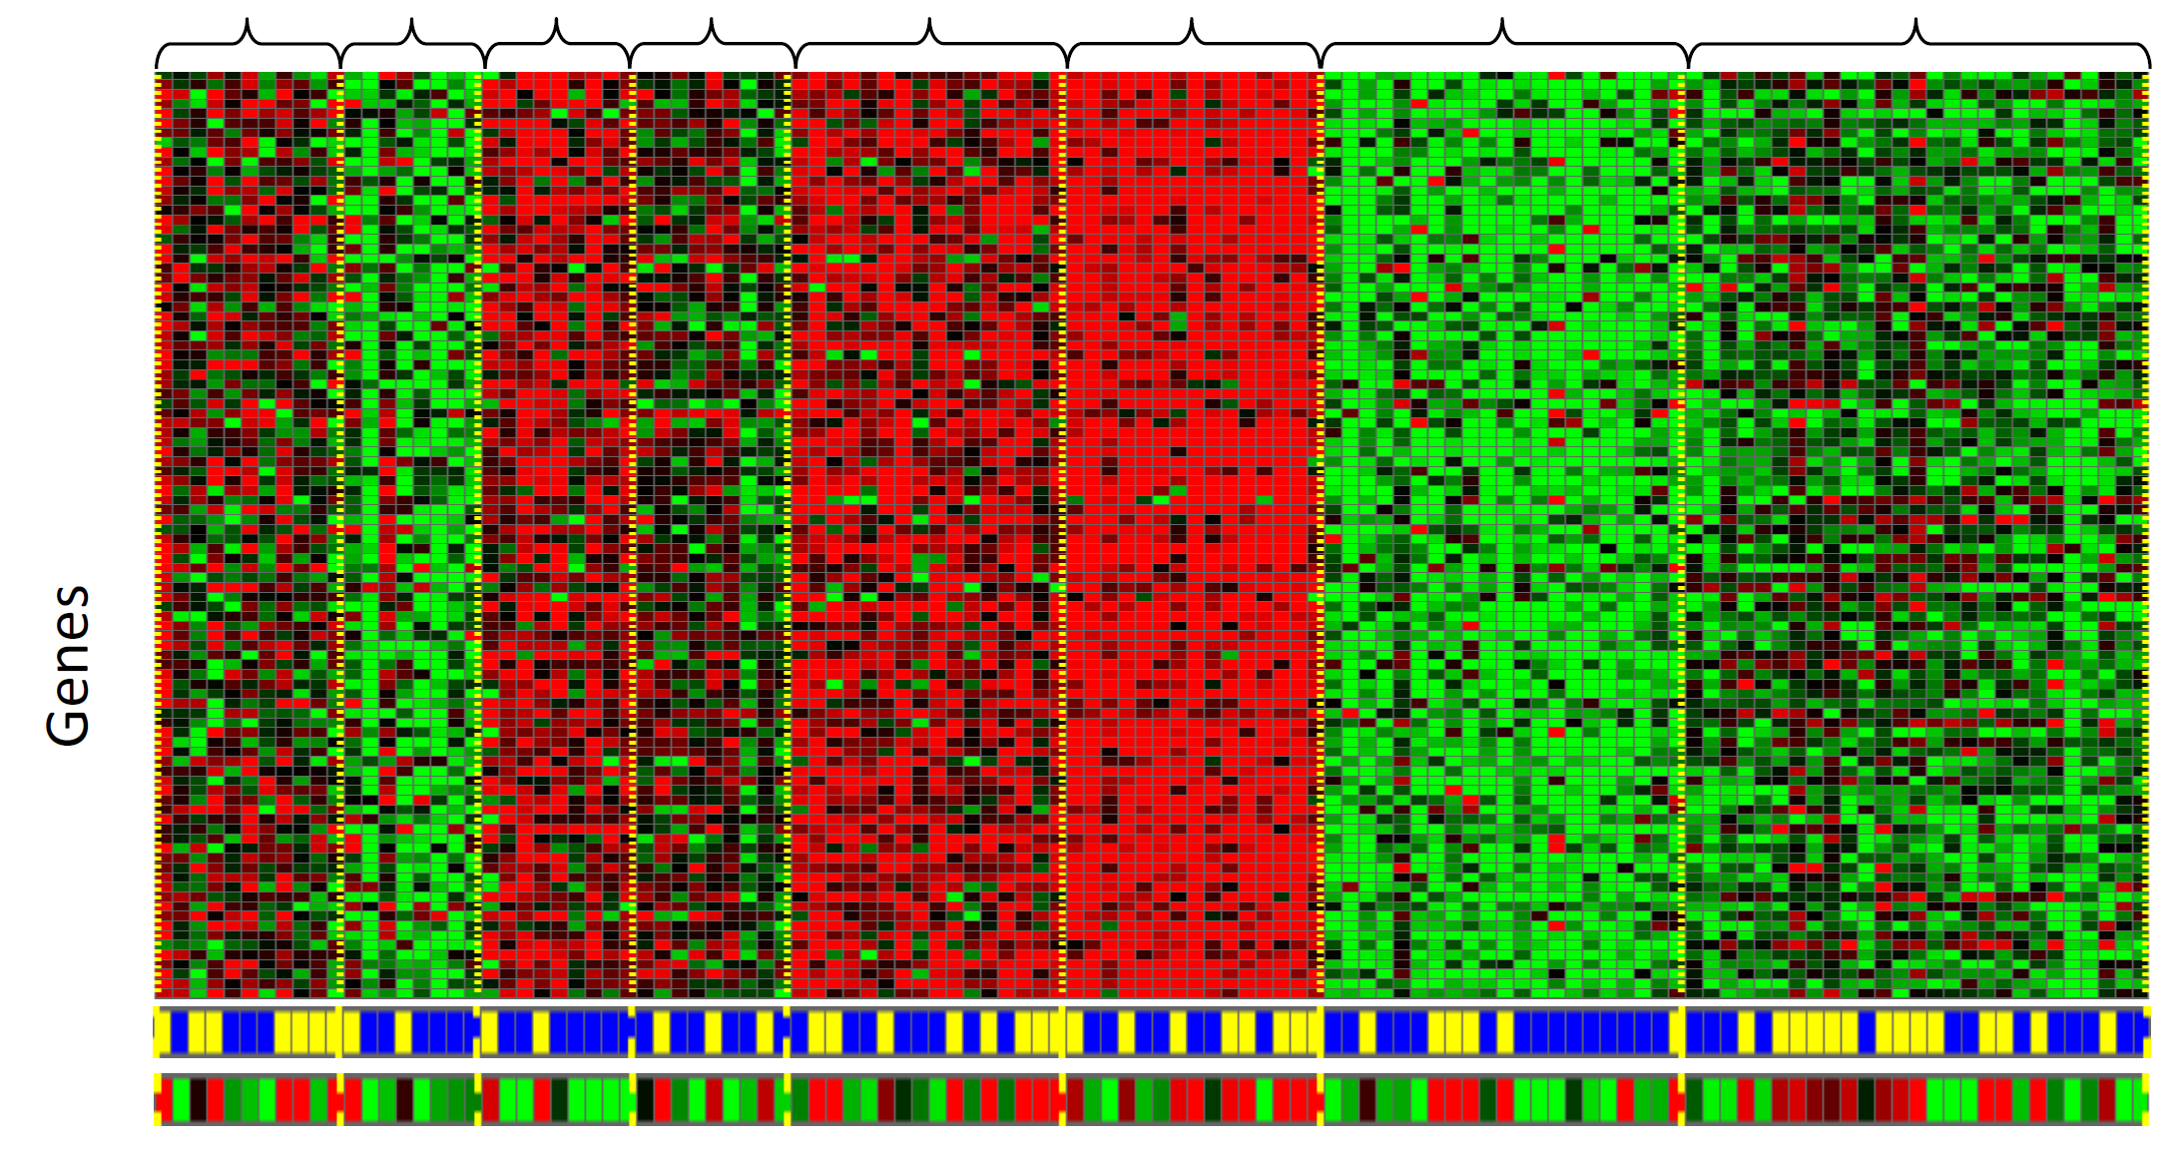
Unsupervised Learning: Genomics Application--Group Individuals by Genetic Similarity
Individuals
[Source: Daphne Koller]

Slide 33

Unsupervised Learning: Clustering

Slide 34



Unsupervised Learning: Other Examples
S

Slide 35

Overview of Reinforcement Learning
Learns by interacting with its environment.
The agent receives rewards by performing correctly and penalties for performing incorrectly, without intervention from human.
Examples:
Credit assignment problem
Game playing
Robot in a maze
Balance a pole on your hand

Slide 36
Framing a Learning Problem

Slide 37
ML in Practice
Understanding domain, prior knowledge, and goals
Data integration, selection, cleaning, pre-processing, etc.
Learning models
Interpreting results
Consolidating and deploying discovered knowledge
Loop

Slide 38

Designing a Learning System

Slide 39
Machine Learning Considerations
Learning Task:
What do we want to learn or predict?
Data and assumptions:
What data do we have available?
What is their quality?
What can we assume about the given problem?
Representation:
What is a suitable representation of the examples to be classified?
Method and Estimation:
Are there possible hypotheses?
Can we adjust our predictions based on the given results?
Evaluation:
How well does the method perform?
Might another approach/model perform better?
Adapted from: http://www.cbs.dtu.dk/~kerner/GeneDisc_Course_2007_MJK/GeneDiscov_2007_MJK.ppt

Slide 40

Machine Learning in Nutshell

Slide 41

Various Function Representations

Slide 42

Various Search/Optimization Algolithms

Slide 43

Evaluation

Slide 44

Machine Learning Frameworks

Slide 45
Demos
Classification
Clustering

